Slide 1
Data Science
Unit 01: Python for Data Science
Lecture 09
Data Visualization using matplotlib

Slide 2
Data Visualization Introduction
matplotlib is a low level graph plotting library in python that serves as a visualization utility.
Matplotlib was created by John D. Hunter.
Matplotlib is open source and we can use it freely.
Matplotlib is mostly written in python, a few segments are written in C, Objective-C and Javascript for Platform compatibility.
f

Slide 3
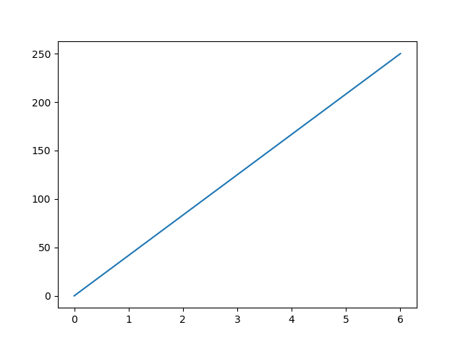
Matplotlib Pyplot
Most of the Matplotlib utilities lies under the pyplot submodule, and are usually imported under the plt alias:
Now the Pyplot package can be referred to as plt.
Example: Draw a line in a diagram from position (0,0) to position (6,250):
import matplotlib.pyplot as plt
import numpy as np
xpoints = np.array([0, 6])
ypoints = np.array([0, 250])
plt.plot(xpoints, ypoints)
plt.show()
f

Slide 4

Matplotlib Plotting
Example
Draw a line in a diagram from position (1, 3) to position (8, 10):
import matplotlib.pyplot as plt
import numpy as np
xpoints = np.array([1, 8])
ypoints = np.array([3, 10])
plt.plot(xpoints, ypoints)
plt.show()
Plotting x and y points
The plot() function is used to draw points (markers) in a diagram.
By default, the plot() function draws a line from point to point.
The function takes parameters for specifying points in the diagram.
Parameter 1 is an array containing the points on the x-axis.
Parameter 2 is an array containing the points on the y-axis.
If we need to plot a line from (1, 3) to (8, 10), we have to pass two arrays [1, 8] and [3, 10] to the plot function.

Slide 5
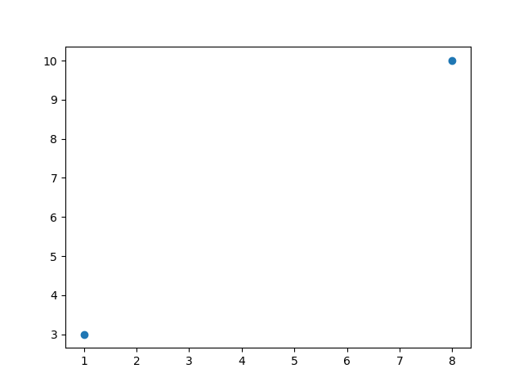
Matplotlib Plotting
Plotting Without Line
To plot only the markers, you can use shortcut string notation parameter 'o', which means 'rings'.
Example: Draw two points in the diagram, one at position (1, 3) and one in position (8, 10):
import matplotlib.pyplot as plt
import numpy as np
xpoints = np.array([1, 8])
ypoints = np.array([3, 10])
plt.plot(xpoints, ypoints, 'o')
plt.show()

Slide 6
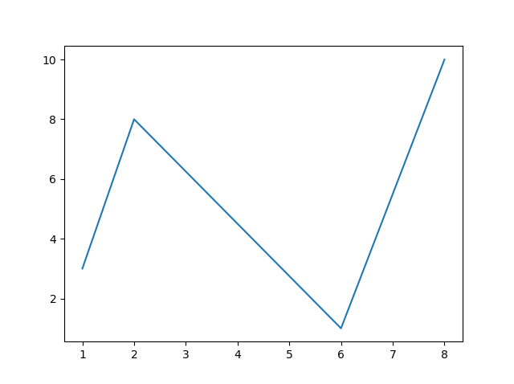
Matplotlib Plotting
Multiple Points
You can plot as many points as you like, just make sure you have the same number of points in both axis.
Example: Draw a line in a diagram from position (1, 3) to (2, 8) then to (6, 1) and finally to position (8, 10):
import matplotlib.pyplot as plt
import numpy as np
xpoints = np.array([1, 2, 6, 8])
ypoints = np.array([3, 8, 1, 10])
plt.plot(xpoints, ypoints)
plt.show()

Slide 7
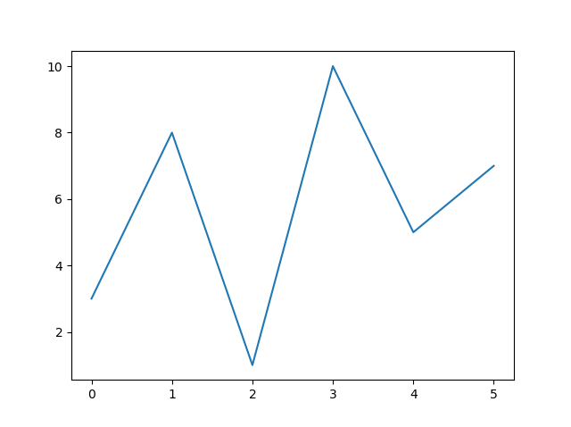
Matplotlib Plotting
Default X-Points
If we do not specify the points on the x-axis, they will get the default values 0, 1, 2, 3 (etc., depending on the length of the y-points.
So, if we take the same example as above, and leave out the x-points, the diagram will look like this:
Example: Plotting without x-points:
import matplotlib.pyplot as plt
import numpy as np
ypoints = np.array([3, 8, 1, 10, 5, 7])
plt.plot(ypoints)
plt.show()

Slide 8
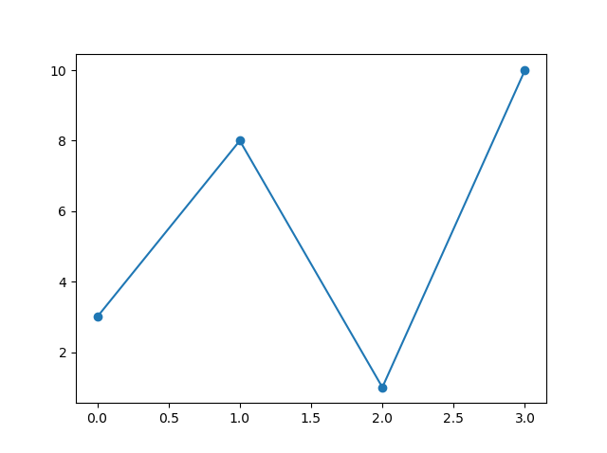
Matplotlib Markers
Markers
You can use the keyword argument marker to emphasize each point with a specified marker:
Example: Mark each point with a circle:
import matplotlib.pyplot as plt
import numpy as np
ypoints = np.array([3, 8, 1, 10])
plt.plot(ypoints, marker = 'o')
plt.show()

Slide 9
Matplotlib Markers
Marker | Description
'o' | Circle
'*' | Star
'.' | Point
',' | Pixel
'x' | X
'X' | X (filled)
'+' | Plus
'P' | Plus (filled)
's' | Square
'D' | Diamond
'd' | Diamond (thin)
'p' | Pentagon
'H' | Hexagon
'h' | Hexagon
'v' | Triangle Down
'^' | Triangle Up
'<' | Triangle Left
'>' | Triangle Right
'1' | Tri Down
'2' | Tri Up
'3' | Tri Left
'4' | Tri Right
'|' | Vline
'_' | Hline

Slide 10
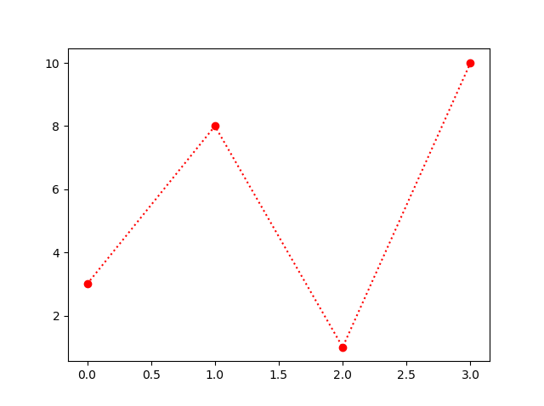
Matplotlib Markers
Format Strings fmt
You can also use the shortcut string notation parameter to specify the marker.
This parameter is also called fmt, and is written with this syntax:
marker|line|color
Example: Mark each point with a circle:
import matplotlib.pyplot as plt
import numpy as np
ypoints = np.array([3, 8, 1, 10])
plt.plot(ypoints, 'o:r')
plt.show()

Slide 11
Matplotlib Markers
The line value can be one of the following:
Line Reference
Note: If you leave out the line value in the fmt parameter, no line will be plotted.
Line Syntax | Description
'-' | Solid line
':' | Dotted line
'--' | Dashed line
'-.' | Dashed/dotted line

Slide 12
Matplotlib Markers
The short color value can be one of the following:
Color Reference
Color Syntax | Description
'r' | Red
'g' | Green
'b' | Blue
'c' | Cyan
'm' | Magenta
'y' | Yellow
'k' | Black
'w' | White

Slide 13
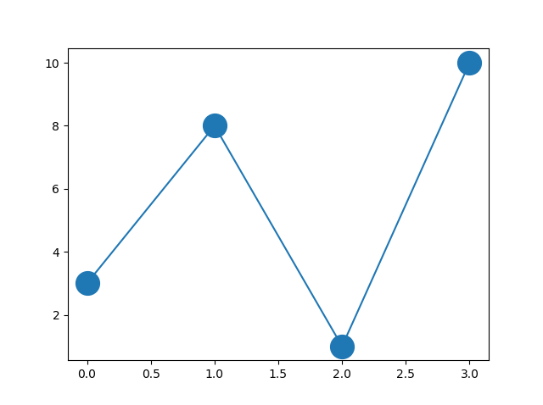
Matplotlib Markers
Marker Size
You can use the keyword argument markersize or the shorter version, ms to set the size of the markers:
Example: Set the size of the markers to 20:
import matplotlib.pyplot as plt
import numpy as np
ypoints = np.array([3, 8, 1, 10])
plt.plot(ypoints, marker = 'o', ms = 20)
plt.show()

Slide 14
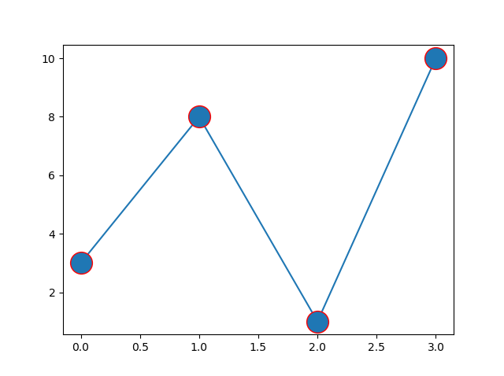
Matplotlib Markers
Marker Color
You can use the keyword argument markeredgecolor or the shorter mec to set the color of the edge of the markers:
Example: Set the EDGE color to red:
import matplotlib.pyplot as plt
import numpy as np
ypoints = np.array([3, 8, 1, 10])
plt.plot(ypoints, marker = 'o', ms = 20, mec = 'r')
plt.show()

Slide 15
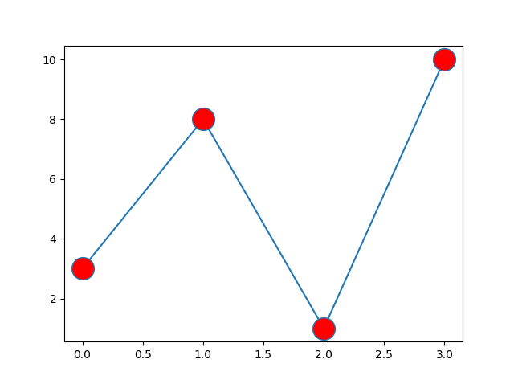
Matplotlib Markers
You can use the keyword argument markerfacecolor or the shorter mfc to set the color inside the edge of the markers:
Example: Set the FACE color to red:
import matplotlib.pyplot as plt
import numpy as np
ypoints = np.array([3, 8, 1, 10])
plt.plot(ypoints, marker = 'o', ms = 20, mfc = 'r')
plt.show()

Slide 16
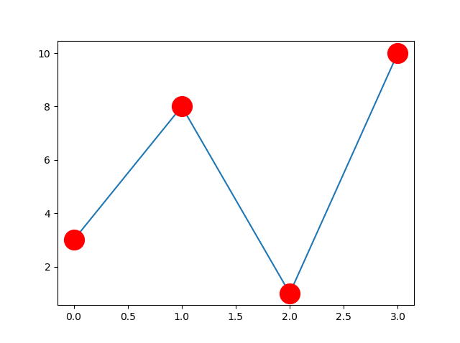
Matplotlib Markers
Use both the mec and mfc arguments to color the entire marker:
You can also use Hexadecimal color values:
  plt.plot(ypoints, marker = 'o', ms = 20, mec = '#4CAF50', mfc = '#4CAF50')
  List of different colours Link
Example: Set the color of both the edge and the face to red:
import matplotlib.pyplot as plt
import numpy as np
ypoints = np.array([3, 8, 1, 10])
plt.plot(ypoints, marker = 'o', ms = 20, mec = 'r', mfc = 'r')
plt.show()

Slide 17
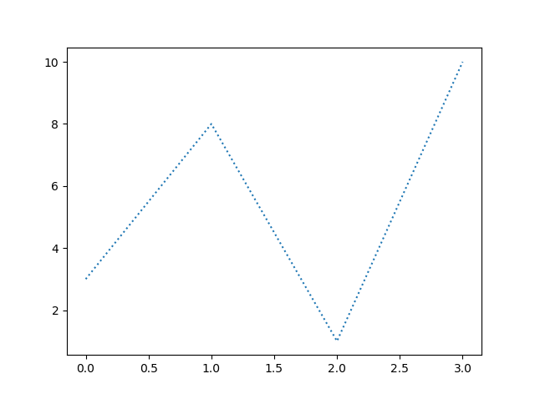
Matplotlib Line
Linestyle: You can use the keyword argument linestyle, or shorter ls, to change the style of the plotted line:
for dash plt.plot(ypoints, linestyle = 'dashed')
Example: Use a dotted line:
import matplotlib.pyplot as plt
import numpy as np
ypoints = np.array([3, 8, 1, 10])
plt.plot(ypoints, linestyle = 'dotted')
plt.show()

Slide 18
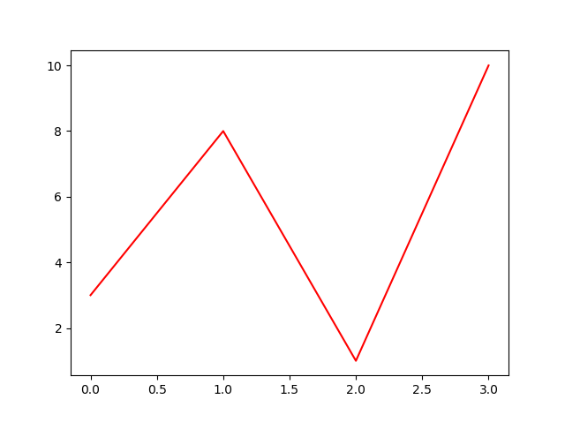
Matplotlib Line
You can use the keyword argument color or the shorter c to set the color of the line:
Example: Set the line color to red:
import matplotlib.pyplot as plt
import numpy as np
ypoints = np.array([3, 8, 1, 10])
plt.plot(ypoints, color = 'r')
plt.show()

Slide 19
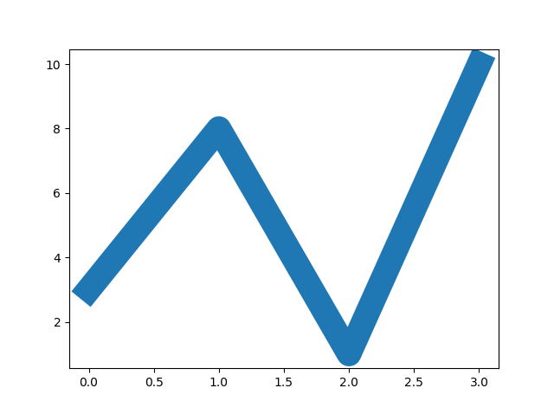
Matplotlib Line
Line Width
You can use the keyword argument linewidth or the shorter lw to change the width of the line.
The value is a floating number, in points:
Example: Plot with a 20.5pt wide line:
import matplotlib.pyplot as plt
import numpy as np
ypoints = np.array([3, 8, 1, 10])
plt.plot(ypoints, linewidth = '20.5')
plt.show()

Slide 20
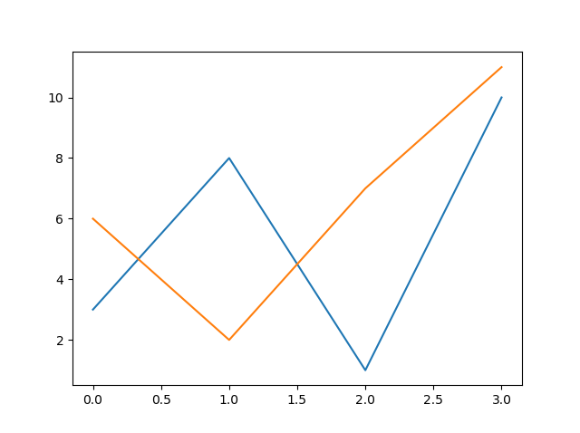
Matplotlib Line
Multiple Lines!
You can plot as many lines as you like by simply adding more plt.plot() functions:
Example: Draw two lines by specifying a plt.plot() function for each line
import matplotlib.pyplot as plt
import numpy as np
y1 = np.array([3, 8, 1, 10])
y2 = np.array([6, 2, 7, 11])
plt.plot(y1)
plt.plot(y2)
plt.show()

Slide 21
Matplotlib Line
Multiple Lines!
You can also plot many lines by adding the points for the x- and y-axis for each line in the same plt.plot() function.
(In the examples above we only specified the points on the y-axis, meaning that the points on the x-axis got the the default values (0, 1, 2, 3).)
The x- and y- values come in pairs:
Example
Draw two lines by specifiyng the x- and y-point values for both lines:
import matplotlib.pyplot as plt
import numpy as np
x1 = np.array([0, 1, 2, 3])
y1 = np.array([3, 8, 1, 10])
x2 = np.array([0, 1, 2, 3])
y2 = np.array([6, 2, 7, 11])
plt.plot(x1, y1, x2, y2)
plt.show()

Slide 22
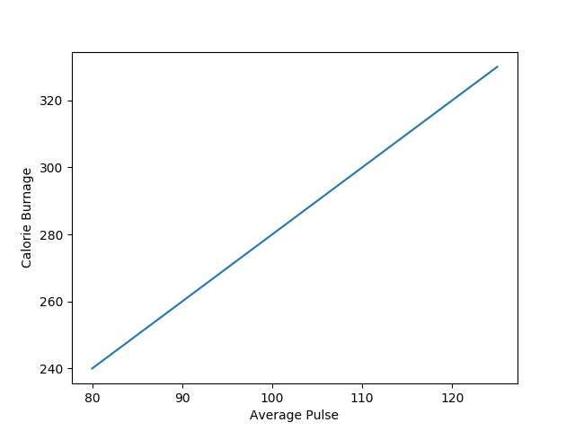
Matplotlib Labels and Title
Create Labels for a Plot
With Pyplot, you can use the xlabel() and ylabel() functions to set a label for the x- and y-axis.
Example: Add labels to the x- and y-axis:
import numpy as np
import matplotlib.pyplot as plt
x = np.array([80, 85, 90, 95, 100, 105, 110, 115, 120, 125])
y = np.array([240, 250, 260, 270, 280, 290, 300, 310, 320, 330])
plt.plot(x, y)
plt.xlabel("Average Pulse")
plt.ylabel("Calorie Burnage")
plt.show()

Slide 23
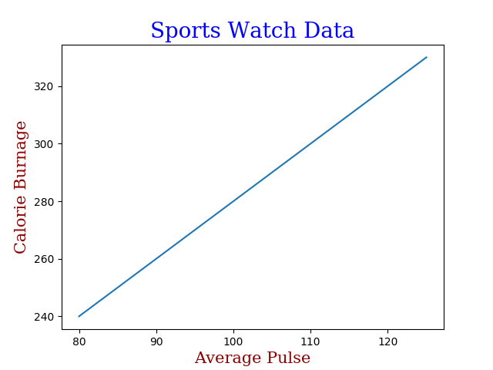
Matplotlib Labels and Title
Set Font Properties for Title and Labels
You can use the fontdict parameter in xlabel(), ylabel(), and title() to set font properties for the title and labels..
Example: Set font properties for the title and labels:
import numpy as np
import matplotlib.pyplot as plt
x = np.array([80, 85, 90, 95, 100, 105, 110, 115, 120, 125])
y = np.array([240, 250, 260, 270, 280, 290, 300, 310, 320, 330])
font1 = {'family':'serif','color':'blue','size':20}
font2 = {'family':'serif','color':'darkred','size':15}
plt.title("Sports Watch Data", fontdict = font1)
plt.xlabel("Average Pulse", fontdict = font2)
plt.ylabel("Calorie Burnage", fontdict = font2)
plt.plot(x, y)
plt.show()

Slide 24
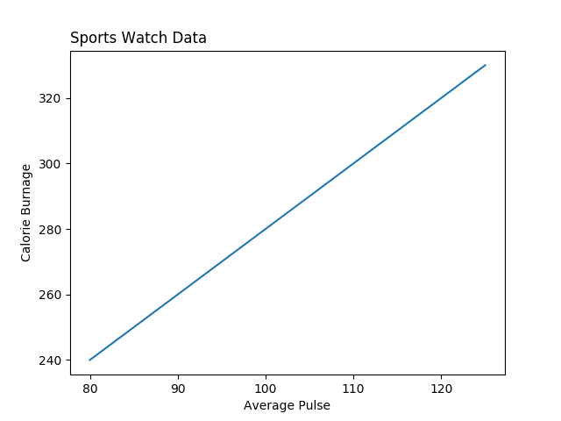
Matplotlib Labels and Title
Position the Title
You can use the loc parameter in title() to position the title.
Legal values are: 'left', 'right', and 'center'. Default value is 'center'.
Example: Position the title to the left:
import numpy as np
import matplotlib.pyplot as plt
x = np.array([80, 85, 90, 95, 100, 105, 110, 115, 120, 125])
y = np.array([240, 250, 260, 270, 280, 290, 300, 310, 320, 330])
plt.title("Sports Watch Data", loc = 'left')
plt.xlabel("Average Pulse")
plt.ylabel("Calorie Burnage")
plt.plot(x, y)
plt.show()

Slide 25
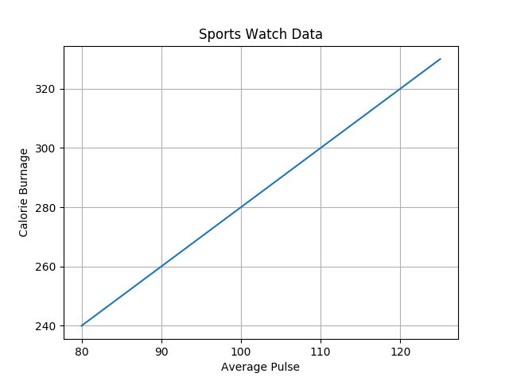
Matplotlib Adding Grid Lines
Add Grid Lines to a Plot
With Pyplot, you can use the grid() function to add grid lines to the plot.
Example: Add grid lines to the plot:
import numpy as np
import matplotlib.pyplot as plt
x = np.array([80, 85, 90, 95, 100, 105, 110, 115, 120, 125])
y = np.array([240, 250, 260, 270, 280, 290, 300, 310, 320, 330])
plt.title("Sports Watch Data")
plt.xlabel("Average Pulse")
plt.ylabel("Calorie Burnage")
plt.plot(x, y)
plt.grid()
plt.show()

Slide 26

Matplotlib Adding Grid Lines
Specify Which Grid Lines to Display
You can use the axis parameter in the grid() function to specify which grid lines to display.
Legal values are: 'x', 'y', and 'both'. Default value is 'both'.
Example: Display only grid lines for the x-axis:
import numpy as np
import matplotlib.pyplot as plt
x = np.array([80, 85, 90, 95, 100, 105, 110, 115, 120, 125])
y = np.array([240, 250, 260, 270, 280, 290, 300, 310, 320, 330])
plt.title("Sports Watch Data")
plt.xlabel("Average Pulse")
plt.ylabel("Calorie Burnage")
plt.plot(x, y)
plt.grid(axis = 'x')# for y plt.grid(axis = 'y')
plt.show()

Slide 27
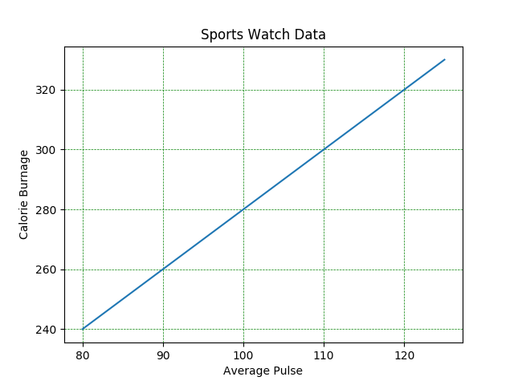
Matplotlib Adding Grid Lines
Set Line Properties for the Grid
You can also set the line properties of the grid, like this: grid(color = 'color', linestyle = 'linestyle', linewidth = number).
Legal values are: 'x', 'y', and 'both'. Default value is 'both'.
Example: Set the line properties of the grid:
import numpy as np
import matplotlib.pyplot as plt
x = np.array([80, 85, 90, 95, 100, 105, 110, 115, 120, 125])
y = np.array([240, 250, 260, 270, 280, 290, 300, 310, 320, 330])
plt.title("Sports Watch Data")
plt.xlabel("Average Pulse")
plt.ylabel("Calorie Burnage")
plt.plot(x, y)
plt.grid(color = 'green', linestyle = '--', linewidth = 0.5)
plt.show()

Slide 28
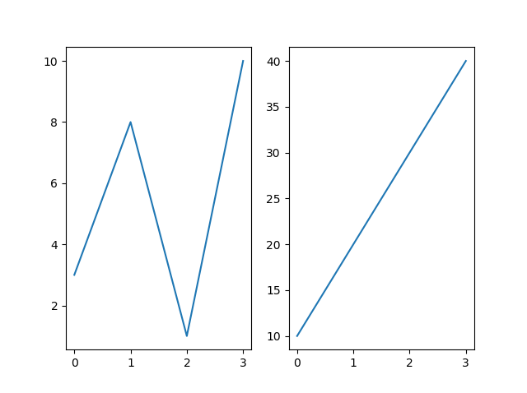
Matplotlib Subplot
Display Multiple Plots
With the subplot() function you can draw multiple plots in one figure:
Example: Draw 2 plots:
import matplotlib.pyplot as plt
import numpy as np
#plot 1:
x = np.array([0, 1, 2, 3])
y = np.array([3, 8, 1, 10])
plt.subplot(1, 2, 1)
plt.plot(x,y)
#plot 2:
x = np.array([0, 1, 2, 3])
y = np.array([10, 20, 30, 40])
plt.subplot(1, 2, 2)
plt.plot(x,y)
plt.show()

Slide 29
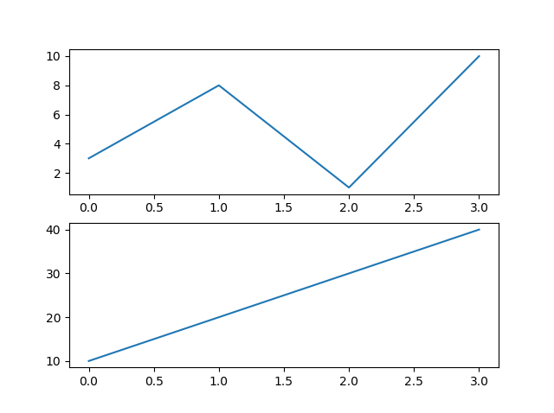
Matplotlib Subplot
Example: Draw 2 plots on top of each other:
import matplotlib.pyplot as plt
import numpy as np
#plot 1:
x = np.array([0, 1, 2, 3])
y = np.array([3, 8, 1, 10])
plt.subplot(2, 1, 1)
plt.plot(x,y)
#plot 2:
x = np.array([0, 1, 2, 3])
y = np.array([10, 20, 30, 40])
plt.subplot(2, 1, 2)
plt.plot(x,y)
plt.show()
The subplot() Function: The subplot() function takes three arguments that describes the layout of the figure.
The layout is organized in rows and columns, that are represented by the first and second argument.
The third argument represents the index of the current plot.
plt.subplot(1, 2, 1) #the figure has 1 row, 2 columns, and this plot is the first plot.
plt.subplot(1, 2, 2) #the figure has 1 row, 2 columns, and this plot is the second plot.
So, if we want a figure with 2 rows an 1 column (meaning that the two plots will be displayed on top of each other instead of side-by-side), we can write the syntax like this: (see example)

Slide 30
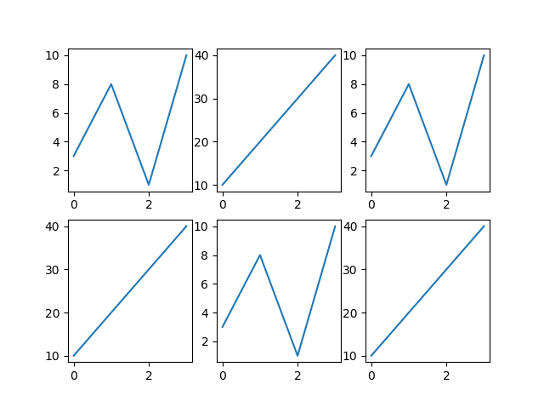
Matplotlib Subplot
Example: Draw 6 plots:
import matplotlib.pyplot as plt
import numpy as np
x = np.array([0, 1, 2, 3])
y = np.array([3, 8, 1, 10])
plt.subplot(2, 3, 1)# This is top left plot
plt.plot(x,y)
x = np.array([0, 1, 2, 3])
y = np.array([10, 20, 30, 40])
plt.subplot(2, 3, 2)# This is top middle
plt.plot(x,y)
x = np.array([0, 1, 2, 3])
y = np.array([3, 8, 1, 10])
plt.subplot(2, 3, 3)# This is top right side plot
plt.plot(x,y)
x = np.array([0, 1, 2, 3])
y = np.array([10, 20, 30, 40])
plt.subplot(2, 3, 4)
plt.plot(x,y)
x = np.array([0, 1, 2, 3])
y = np.array([3, 8, 1, 10])
plt.subplot(2, 3, 5)
plt.plot(x,y)
x = np.array([0, 1, 2, 3])
y = np.array([10, 20, 30, 40])
plt.subplot(2, 3, 6)
plt.plot(x,y)
plt.show()
You can draw as many plots you like on one figure, just describe the number of rows, columns, and the index of the plot.

Slide 31
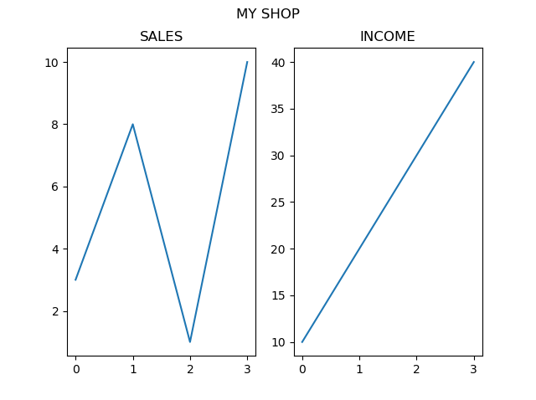
Matplotlib Subplot
Example
Add a title for the entire figure:
import matplotlib.pyplot as plt
import numpy as np
#plot 1:
x = np.array([0, 1, 2, 3])
y = np.array([3, 8, 1, 10])
plt.subplot(1, 2, 1)
plt.plot(x,y)
plt.title("SALES")
#plot 2:
x = np.array([0, 1, 2, 3])
y = np.array([10, 20, 30, 40])
plt.subplot(1, 2, 2)
plt.plot(x,y)
plt.title("INCOME")
plt.suptitle("MY SHOP")
plt.show()
Title: You can add a title to each plot with the title() function:
You can add a title to the entire figure with the suptitle() function:

Slide 32
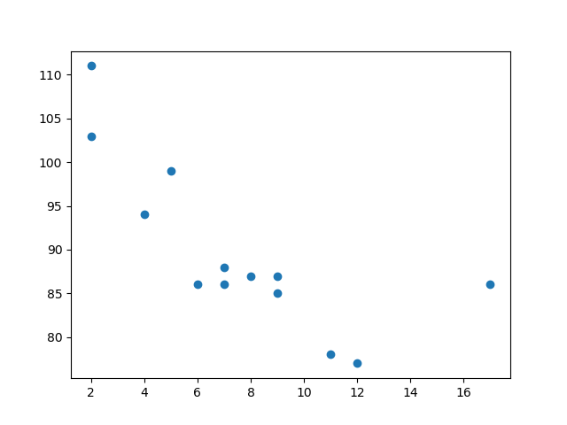
Matplotlib Scatter
Example: A simple scatter plot:
import matplotlib.pyplot as plt
import numpy as np
x = np.array([5,7,8,7,2,17,2,9,4,11,12,9,6])
y = np.array([99,86,87,88,111,86,103,87,94,78,77,85,86])
plt.scatter(x, y)
plt.show()
Creating Scatter Plots: With Pyplot, you can use the scatter() function to draw a scatter plot.
The scatter() function plots one dot for each observation. It needs two arrays of the same length, one for the values of the x-axis, and one for values on the y-axis:
The observation in the example above is the result of 13 cars passing by.
  The X-axis shows how old the car is.
  The Y-axis shows the speed of the car when it passes.
  Are there any relationships between the observations?
  It seems that the newer the car, the faster it drives, but that could be a coincidence, after all we only registered 13 cars.

Slide 33
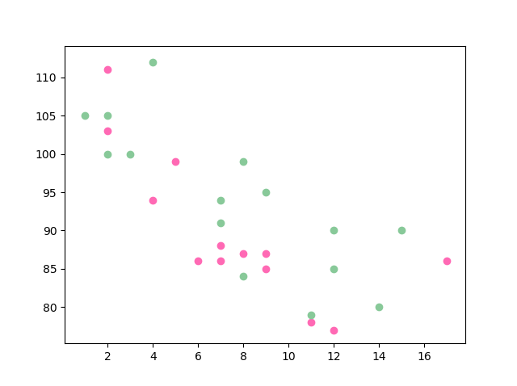
Matplotlib Scatter
Example
Draw two plots on the same figure:
import matplotlib.pyplot as plt
import numpy as np
#day one, the age and speed of 13 cars:
x = np.array([5,7,8,7,2,17,2,9,4,11,12,9,6])
y = np.array([99,86,87,88,111,86,103,87,94,78,77,85,86])
plt.scatter(x, y, color = 'hotpink')# without colour plt.scatter(x, y)
#day two, the age and speed of 15 cars:
x = np.array([2,2,8,1,15,8,12,9,7,3,11,4,7,14,12])
y = np.array([100,105,84,105,90,99,90,95,94,100,79,112,91,80,85])
plt.scatter(x, y, color = '#88c999')# without colour plt.scatter(x, y)
plt.show()
Compare Plots: In the example, there seems to be a relationship between speed and age, but what if we plot the observations from another day as well? Will the scatter plot tell us something else?
You can set your own color for each scatter plot with the color or the c argument:
Homework: Color each dot and color map is your homework. Both are part of your course.

Slide 34
Matplotlib Bars
Creating Bars
With Pyplot, you can use the bar() function to draw bar graphs
The bar() function takes arguments that describes the layout of the bars.
The categories and their values represented by the first and second argument as arrays
If you want the bars to be displayed horizontally instead of vertically, use the barh() function
The bar() and barh() take the keyword argument color to set the color of the bars
The bar() takes the keyword argument width to set the width of the bars
The barh() takes the keyword argument height to set the height of the bars

Slide 35
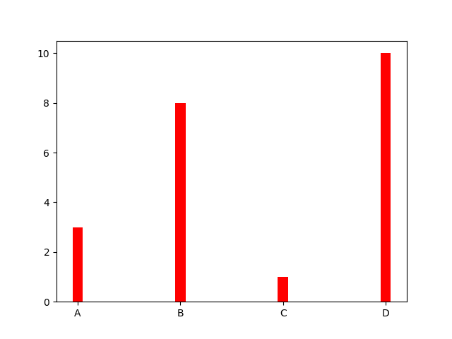
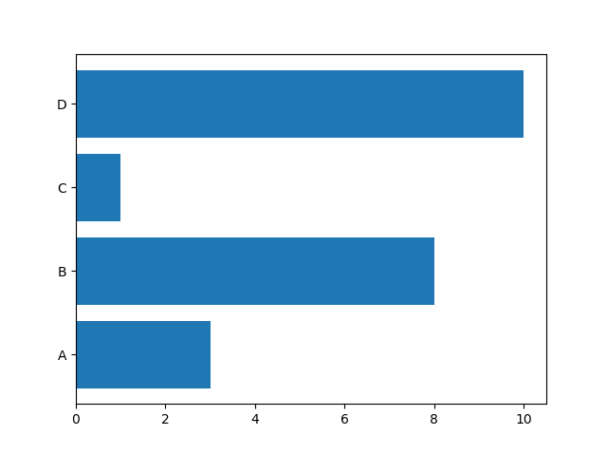
Matplotlib Bars
import matplotlib.pyplot as plt
import numpy as np
x = np.array(["A", "B", "C", "D"])
y = np.array([3, 8, 1, 10])
plt.bar(x, y, width = 0.1, color = "red")
# for horizontal bar plot plt.barh(x, y, height = 0.1, color=“blue”)
plt.show()

Slide 36
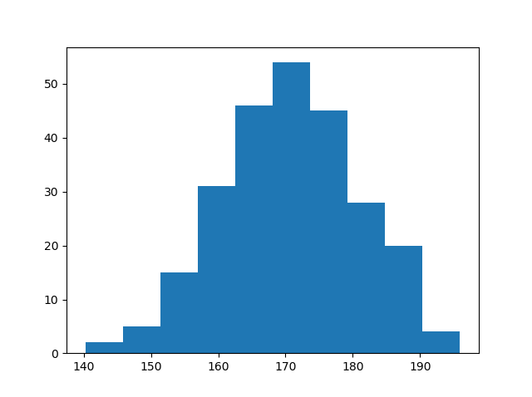
Matplotlib Histograms
A histogram is a graph showing frequency distributions.
It is a graph showing the number of observations within each given interval.
Example: Say you ask for the height of 250 people, you might end up with a histogram like this:
You can read from the histogram that there are approximately:
  2 people from 140 to 145cm
  5 people from 145 to 150cm
  15 people from 151 to 156cm
  31 people from 157 to 162cm
  46 people from 163 to 168cm
  53 people from 168 to 173cm
  45 people from 173 to 178cm
  28 people from 179 to 184cm
  21 people from 185 to 190cm
  4 people from 190 to 195cm

Slide 37
Matplotlib Histograms
[167.62255766 175.32495609 152.84661337 165.50264047 163.17457988
162.29867872 172.83638413 168.67303667 164.57361342 180.81120541
170.57782187 167.53075749 176.15356275 176.95378312 158.4125473
187.8842668 159.03730075 166.69284332 160.73882029 152.22378865
164.01255164 163.95288674 176.58146832 173.19849526 169.40206527
166.88861903 149.90348576 148.39039643 177.90349066 166.72462233
177.44776004 170.93335636 173.26312881 174.76534435 162.28791953
166.77301551 160.53785202 170.67972019 159.11594186 165.36992993
178.38979253 171.52158489 173.32636678 159.63894401 151.95735707
175.71274153 165.00458544 164.80607211 177.50988211 149.28106703
179.43586267 181.98365273 170.98196794 179.1093176 176.91855744
168.32092784 162.33939782 165.18364866 160.52300507 174.14316386
163.01947601 172.01767945 173.33491959 169.75842718 198.04834503
192.82490521 164.54557943 206.36247244 165.47748898 195.26377975
164.37569092 156.15175531 162.15564208 179.34100362 167.22138242
147.23667125 162.86940215 167.84986671 172.99302505 166.77279814
196.6137667 159.79012341 166.5840824 170.68645637 165.62204521
174.5559345 165.0079216 187.92545129 166.86186393 179.78383824
161.0973573 167.44890343 157.38075812 151.35412246 171.3107829
162.57149341 182.49985133 163.24700057 168.72639903 169.05309467
167.19232875 161.06405208 176.87667712 165.48750185 179.68799986
158.7913483 170.22465411 182.66432721 173.5675715 176.85646836
157.31299754 174.88959677 183.78323508 174.36814558 182.55474697
180.03359793 180.53094948 161.09560099 172.29179934 161.22665588
171.88382477 159.04626132 169.43886536 163.75793589 157.73710983
174.68921523 176.19843414 167.39315397 181.17128255 174.2674597
186.05053154 177.06516302 171.78523683 166.14875436 163.31607668
174.01429569 194.98819875 169.75129209 164.25748789 180.25773528
170.44784934 157.81966006 171.33315907 174.71390637 160.55423274
163.92896899 177.29159542 168.30674234 165.42853878 176.46256226
162.61719142 166.60810831 165.83648812 184.83238352 188.99833856
161.3054697 175.30396693 175.28109026 171.54765201 162.08762813
164.53011089 189.86213299 170.83784593 163.25869004 198.68079225
166.95154328 152.03381334 152.25444225 149.75522816 161.79200594
162.13535052 183.37298831 165.40405341 155.59224806 172.68678385
179.35359654 174.19668349 163.46176882 168.26621173 162.97527574
192.80170974 151.29673582 178.65251432 163.17266558 165.11172588
183.11107905 169.69556831 166.35149789 178.74419135 166.28562032
169.96465166 178.24368042 175.3035525 170.16496554 158.80682882
187.10006553 178.90542991 171.65790645 183.19289193 168.17446717
155.84544031 177.96091745 186.28887898 187.89867406 163.26716924
169.71242393 152.9410412 158.68101969 171.12655559 178.1482624
187.45272185 173.02872935 163.8047623 169.95676819 179.36887054
157.01955088 185.58143864 170.19037101 157.221245 168.90639755
178.7045601 168.64074373 172.37416382 165.61890535 163.40873027
168.98683006 149.48186389 172.20815568 172.82947206 173.71584064
189.42642762 172.79575803 177.00005573 169.24498561 171.55576698
161.36400372 176.47928342 163.02642822 165.09656415 186.70951892
153.27990317 165.59289527 180.34566865 189.19506385 183.10723435
173.48070474 170.28701875 157.24642079 157.9096498 176.4248199 ]
Create Histogram: In Matplotlib, we use the hist() function to create histograms.
The hist() function will use an array of numbers to create a histogram, the array is sent into the function as an argument.
For simplicity we use NumPy to randomly generate an array with 250 values, where the values will concentrate around 170, and the standard deviation is 10.
import numpy as np
x = np.random.normal(170, 10, 250)
print(x)

Slide 38
Matplotlib Histograms
[167.62255766 175.32495609 152.84661337 165.50264047 163.17457988
162.29867872 172.83638413 168.67303667 164.57361342 180.81120541
170.57782187 167.53075749 176.15356275 176.95378312 158.4125473
187.8842668 159.03730075 166.69284332 160.73882029 152.22378865
164.01255164 163.95288674 176.58146832 173.19849526 169.40206527
166.88861903 149.90348576 148.39039643 177.90349066 166.72462233
177.44776004 170.93335636 173.26312881 174.76534435 162.28791953
166.77301551 160.53785202 170.67972019 159.11594186 165.36992993
178.38979253 171.52158489 173.32636678 159.63894401 151.95735707
175.71274153 165.00458544 164.80607211 177.50988211 149.28106703
179.43586267 181.98365273 170.98196794 179.1093176 176.91855744
168.32092784 162.33939782 165.18364866 160.52300507 174.14316386
163.01947601 172.01767945 173.33491959 169.75842718 198.04834503
192.82490521 164.54557943 206.36247244 165.47748898 195.26377975
164.37569092 156.15175531 162.15564208 179.34100362 167.22138242
147.23667125 162.86940215 167.84986671 172.99302505 166.77279814
196.6137667 159.79012341 166.5840824 170.68645637 165.62204521
174.5559345 165.0079216 187.92545129 166.86186393 179.78383824
161.0973573 167.44890343 157.38075812 151.35412246 171.3107829
162.57149341 182.49985133 163.24700057 168.72639903 169.05309467
167.19232875 161.06405208 176.87667712 165.48750185 179.68799986
158.7913483 170.22465411 182.66432721 173.5675715 176.85646836
157.31299754 174.88959677 183.78323508 174.36814558 182.55474697
180.03359793 180.53094948 161.09560099 172.29179934 161.22665588
171.88382477 159.04626132 169.43886536 163.75793589 157.73710983
174.68921523 176.19843414 167.39315397 181.17128255 174.2674597
186.05053154 177.06516302 171.78523683 166.14875436 163.31607668
174.01429569 194.98819875 169.75129209 164.25748789 180.25773528
170.44784934 157.81966006 171.33315907 174.71390637 160.55423274
163.92896899 177.29159542 168.30674234 165.42853878 176.46256226
162.61719142 166.60810831 165.83648812 184.83238352 188.99833856
161.3054697 175.30396693 175.28109026 171.54765201 162.08762813
164.53011089 189.86213299 170.83784593 163.25869004 198.68079225
166.95154328 152.03381334 152.25444225 149.75522816 161.79200594
162.13535052 183.37298831 165.40405341 155.59224806 172.68678385
179.35359654 174.19668349 163.46176882 168.26621173 162.97527574
192.80170974 151.29673582 178.65251432 163.17266558 165.11172588
183.11107905 169.69556831 166.35149789 178.74419135 166.28562032
169.96465166 178.24368042 175.3035525 170.16496554 158.80682882
187.10006553 178.90542991 171.65790645 183.19289193 168.17446717
155.84544031 177.96091745 186.28887898 187.89867406 163.26716924
169.71242393 152.9410412 158.68101969 171.12655559 178.1482624
187.45272185 173.02872935 163.8047623 169.95676819 179.36887054
157.01955088 185.58143864 170.19037101 157.221245 168.90639755
178.7045601 168.64074373 172.37416382 165.61890535 163.40873027
168.98683006 149.48186389 172.20815568 172.82947206 173.71584064
189.42642762 172.79575803 177.00005573 169.24498561 171.55576698
161.36400372 176.47928342 163.02642822 165.09656415 186.70951892
153.27990317 165.59289527 180.34566865 189.19506385 183.10723435
173.48070474 170.28701875 157.24642079 157.9096498 176.4248199 ]
Example
A simple histogram:
import matplotlib.pyplot as plt
import numpy as np
x = np.random.normal(170, 10, 250)
plt.hist(x)
plt.show()

Slide 39
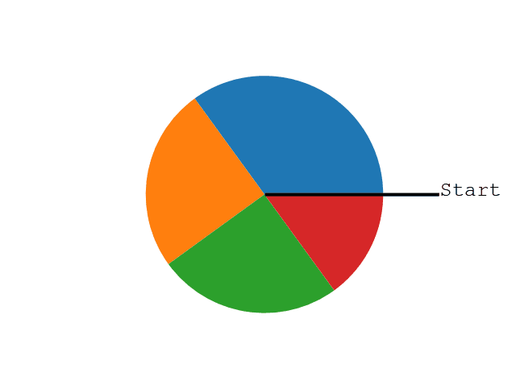
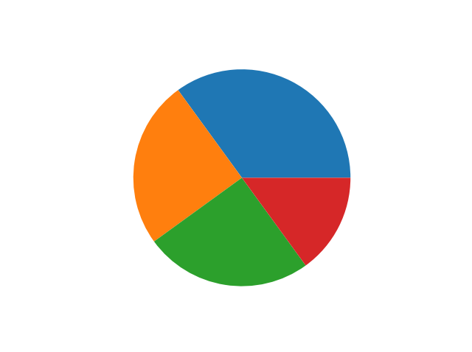
Matplotlib Pie Charts
Creating Pie Charts: With Pyplot, you can use the pie() function to draw pie charts:
As you can see the pie chart draws one piece (called a wedge) for each value in the array (in this case [35, 25, 25, 15]).
By default the plotting of the first wedge starts from the x-axis and moves counterclockwise:
Note: The size of each wedge is determined by comparing the value with all the other values, by using this formula:
The value divided by the sum of all values: x/sum(x)
Example:A simple pie chart:
import matplotlib.pyplot as plt
import numpy as np
y = np.array([35, 25, 25, 15])
plt.pie(y)
plt.show()

Slide 40
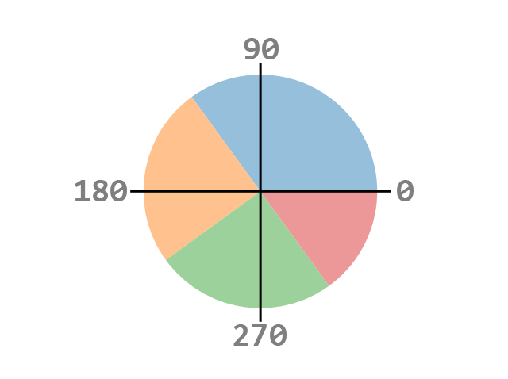
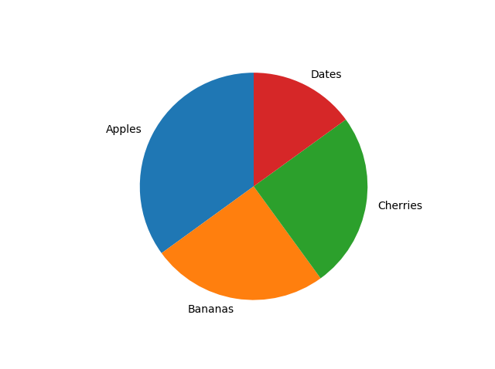
Matplotlib Pie Charts
Labels: Add labels to the pie chart with the label parameter.
The label parameter must be an array with one label for each wedge:
Start Angle: As mentioned the default start angle is at the x-axis, but you can change the start angle by specifying a startangle parameter.
The startangle parameter is defined with an angle in degrees, default angle is 0:
Example: Start the first wedge at 90 degrees:
import matplotlib.pyplot as plt
import numpy as np
y = np.array([35, 25, 25, 15])
mylabels = ["Apples", "Bananas", "Cherries", "Dates"]
plt.pie(y, labels = mylabels, startangle = 90)
plt.show()

Slide 41
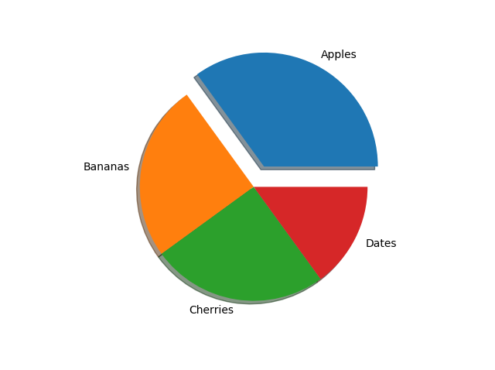
Matplotlib Pie Charts
Explode: Maybe you want one of the wedges to stand out? The explode parameter allows you to do that.
The explode parameter, if specified, and not None, must be an array with one value for each wedge.
Each value represents how far from the center each wedge is displayed:
Shadow: Add a shadow to the pie chart by setting the shadows parameter to True:
Example: Add a shadow and explode:
import matplotlib.pyplot as plt
import numpy as np
y = np.array([35, 25, 25, 15])
mylabels = ["Apples", "Bananas", "Cherries", "Dates"]
myexplode = [0.2, 0, 0, 0]
plt.pie(y, labels = mylabels, explode = myexplode, shadow = True)
plt.show()

Slide 42
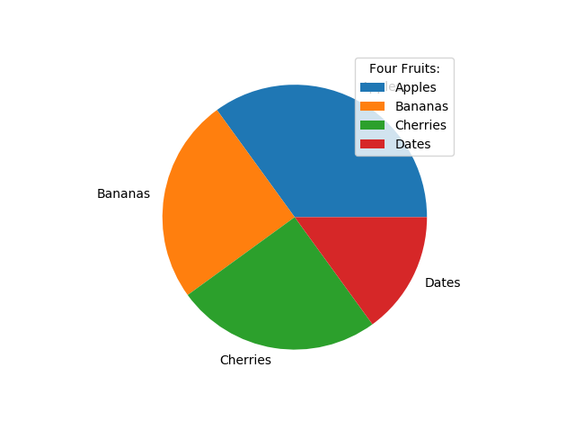
Matplotlib Pie Charts
Colors: You can set the color of each wedge with the colors parameter
The colors parameter, if specified, must be an array with one value for each wedge
Legend: To add a list of explanation for each wedge, use the legend() function:
Legend With Header: To add a header to the legend, add the title parameter to the legend function.
Example: Add a legend with a header:
import matplotlib.pyplot as plt
import numpy as np
y = np.array([35, 25, 25, 15])
mylabels = ["Apples", "Bananas", "Cherries", "Dates"]
plt.pie(y, labels = mylabels)
plt.legend(title = "Four Fruits:")
plt.show()

Slide 43
Summary
In this lecture we learned following concepts:
  Data visualization using matplotlib
    Line plot
    Bar charts
    Histograms
    Scatter plot
    Pie charts
    Subplots

